Slide 1
INTERNSHIP PRESENTATION
-GAGAN A (4UB19CS021)
-HARISH J LAMANI (4UB19CS023)
-KAVYA S T (4UB19CS024)

Slide 2

ABOUT THE COMPANY
Name of the Company : Sumukha Info Tech
Started on 08/08/2018, Sumukha InfoTech’s vision is to contribute to the society in a bigger way.
Vision: Help improve the quality of life’s of people through our software products and through our social service activities.
Mission: To deliver quality product and services and to build trust and good relation with clients and society.
Values: Stick on to our ethics of being transparent and to provide maximum value to our clients.

Slide 3
OVERVIEW OF INTERNSHIP
WEEKS | ACTIVITY
FIRST | Python programming language
SECOND | Modules in Python
THIRD | Machine Learning Algorithm
FOURTH | Flask Framework and Environmental setup
FIVE | Project Based Learning

Slide 4
TASK PERFORMED
BASICS OF Python
DIFFERENT Modules in python
Machine learning algorithmS
Project based learning

Slide 5
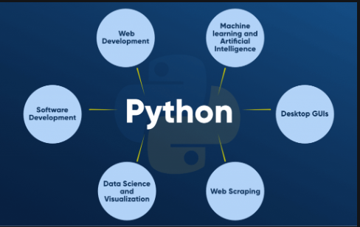
INTRODUCTION TO PYTHON

Slide 6
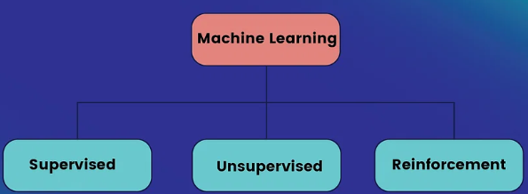
MACHINE LEARNING
Machine Learning is an application of AI that provides systems the ability to automatically learn and improve from experience without being explicitly programmed.
Various types of algorithm
1.Linear Regression
2.Decision Tree
3.KNN(k-Nearest Neighbours)
4.CNN(Convolutional Neural Network)

Slide 7
PROJECT IMPLEMENTATION
We have done a project on Kidney stone detection system using CNN algorithm.
IMPLEMENATION
1.Image Pre-processing
2.Image acquisition from dataset
3.Image classification using convolutional neural network
*Sequential
*Convolution
*Pooling
*Flattening
*Fully connections

Slide 8
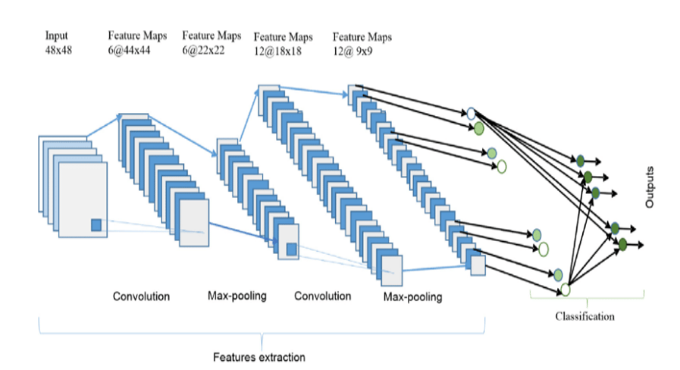
CNN ARCHITECTURE

Slide 9
FLASK FRAMEWORK
Flask is a high-level Python Web framework that encourages rapid development and clean, pragmatic design.
Built by experienced developers, it takes care of much of the hassle of Web development, so you can focus on writing your app without needing to reinvent the wheel.
It’s free and open source.
Features
1.Ridiculously fast
2.Reassuring secure
3.Exceedingly scalable

Slide 10
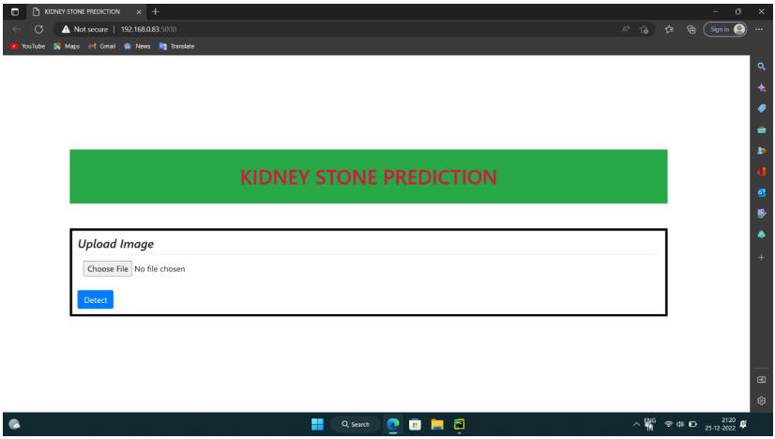
SNAP SHOTS
INPUT AN IMAGE

Slide 11
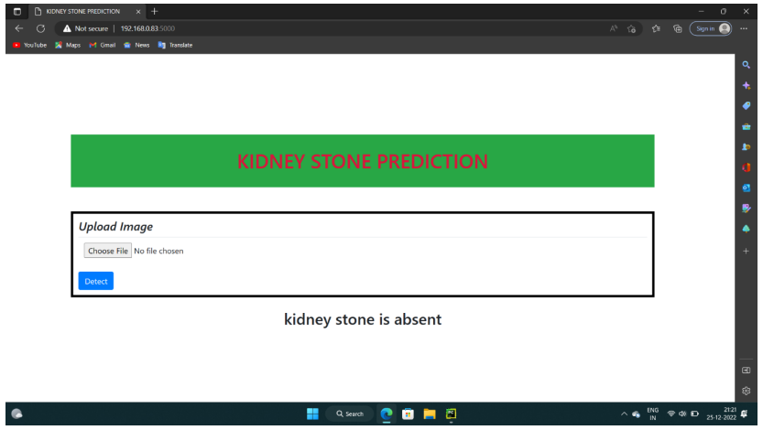
Predicted Result for absence of kidney stone

Slide 12
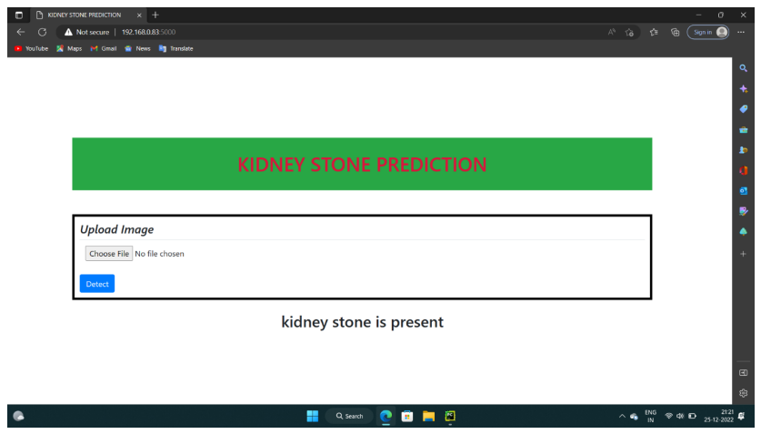
Predicted Result for presence of kidney stone

Slide 13
CONCLUSION
The main objective of our project was to purpose an automatic method for detecting the stones present in kidney.We have concluded that the detection of kidney stones using machine learning algorithm have provided 92% accuracy.

Slide 14
THANK YOU

